Slide 1
Delivery Playbook - Java
March 2024
Aug 2020

Slide 2

Purpose of this playbook
Objective:
The aim of the playbook is to be a one stop shop for project teams to understand the recommended approach and have access to project resources to simplify implementation
Document Scope
Describe the approach to overall delivery of a typical Java project for a subset of the organization( wave) that is embarking upon larger transformation program
Provide detailed guidance/picture on the key activities to be performed as part of overall Delivery
Recommended Project execution life Cycles @Capgemini
Guidelines and roadmaps to be followed for a selected SDLC cycle
Standards and tools applicable for engagements
Methodology and checklists
Governance and Reusable artifacts
Out of scope
Does not explore the benefits and rationale for adopting a particular way of delivery cycle
Does not provide a holistic compendium/how to guide on the Delivery process.
This playbook is a living document that will evolve as the team continues to embark of new projects and learn through its implementation.

Slide 3






Contents of this playbook
Audience
Technology teams can use this playbook to guide their projects and quickly get started delivering high value software.
Engineers can use this playbook to improve their own skills around successful software delivery, making them stand apart from their peers.
Anyone interested in learning about engineering delivery will find this a valuable resource, particularly in regard to being thorough and consistent.
Component
Questions addressed
Concepts
What are the best practices during the entire SDLC
Set up and Guidelines
Which are the best practices used during every SDLC stage
Templates/Example
How does it work in practice
Checklists
What are the guard rails and guide rails
Phase wise tools
Which Tools to be used during each phase
References & Inventory
References ( internal and external)

Slide 4
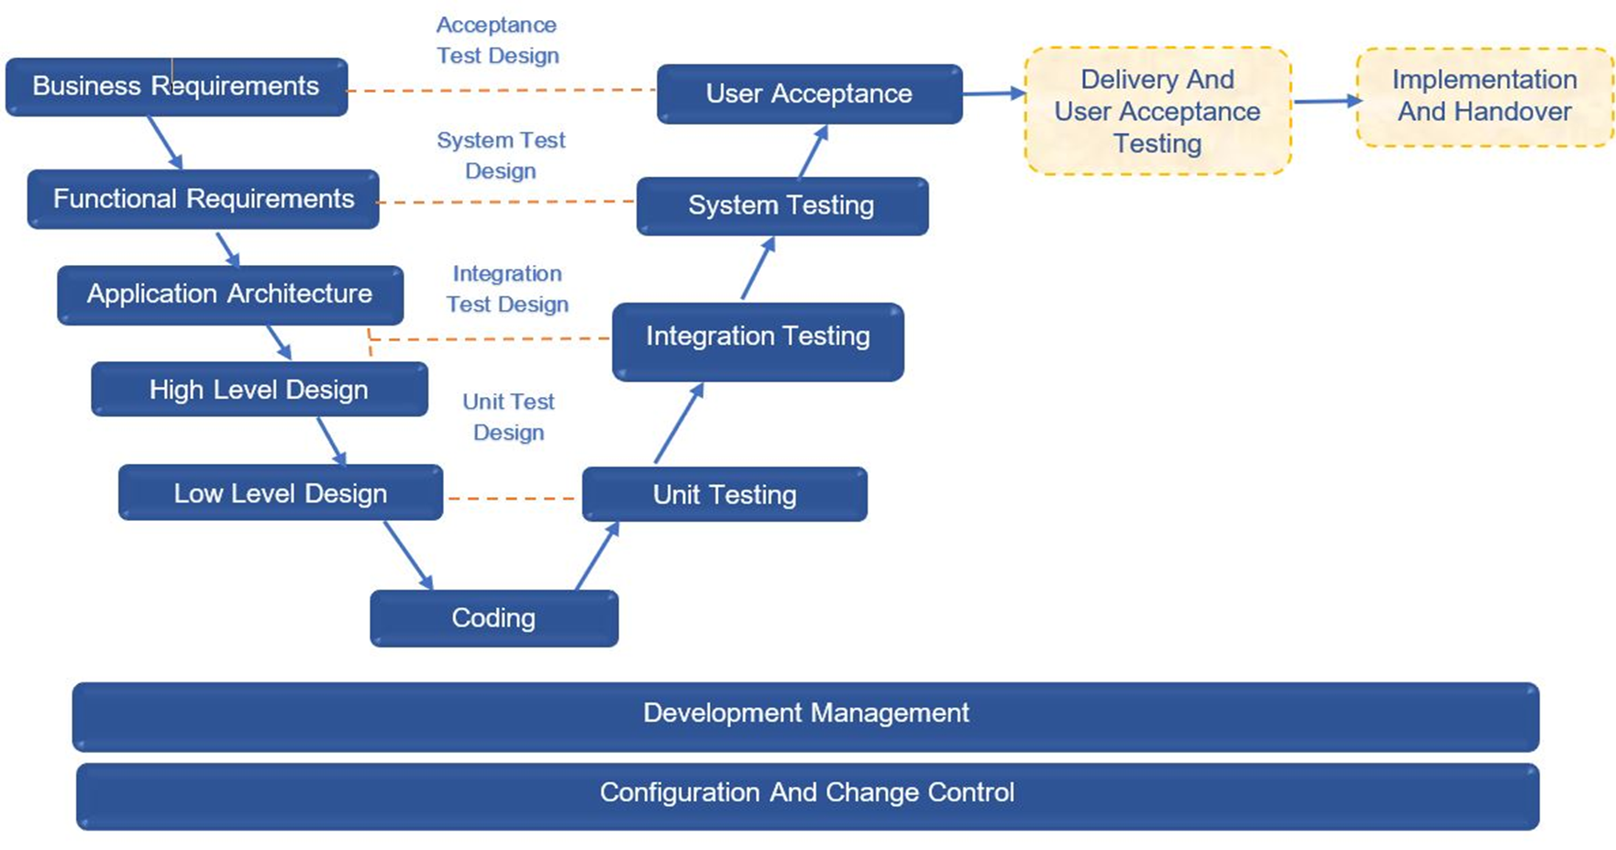
Typical Java Delivery lifecycle
* It is a combination of Waterfall fall model and V-model with review and testing activity built into each phase of the process.
** mandates performing reviews under each phase. It is recommended that Quality Gate/ Phase end reviews are also done by the Engagements.
** This method is not suitable for the projects where requirements are evolving

Slide 5
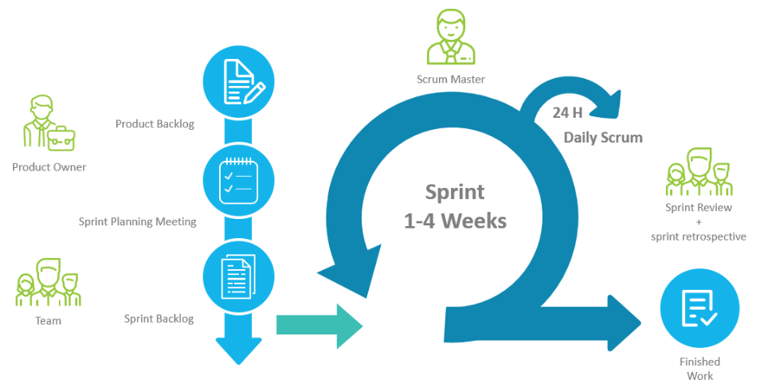
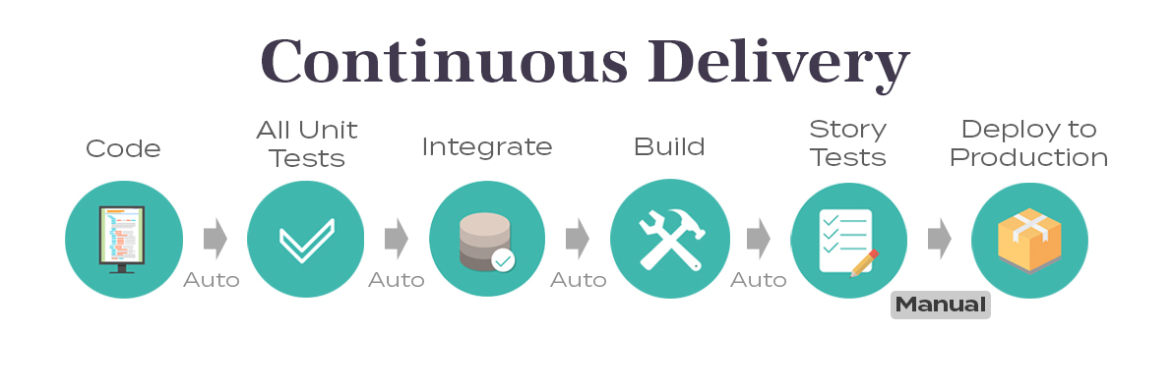
Typical Agile Product Delivery lifecycle
This method is suitable for the projects where requirements are evolving

Slide 6


















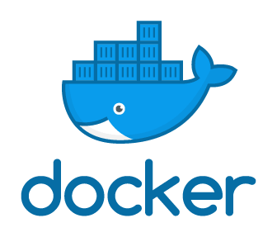






Typical CI-CD Pipeline Steps
Design & Planning
NFR Validation
Development
Source Control
Build
Code Quality
Deployment
Testing
UAT
Release Validation
Deploy
Design &
Planning
assess architecture to support NFR’s and attach them as constraints
Code
Development
(Sample Tool Sets and templates)
Singular integrated version Control management
Autonomous Build & Testing, Continuous Testing and Integration
Standardize Automated
Code Review Rules
Build artifact are Continuously Deployed and smoke tested
Retrieve build artefacts & environments in real-time for continuous testing
Automated User Acceptance Testing as subset of overall QE
V&V Summary Report, approval via workflow and Digital labor
Packaging the tested code and deployed in production
Ci/CD Flow
CI/CD/CT +NFR (Non Functional Requirements) will continue to evolve & standardized, mainly around the app types like fast moving Apps (Digital, DHCC) versus ERP
Recommended CI-CD Pipeline TOOLS – Step WISE
Low Code
Documentation
Validation Master Plan
Traceability Matrix
Enterprise Architecture
UAT performed on the pre-prod/ training environment`
Validation QA Summary Report
Captures all the steps, results & its evidence
Quality Gates
Standard Rules
Faster feedback
EasyRepro
Application monitoring
Logs and events tracking
Loosely Coupled Toolset
Note: Only Sample tool sets are represented
Epic/Stories
Tracking

Slide 7
Recommended Standards, Tools, Frameworks
Standards/Tools/Frameworks | Recommendations | Gen AI | Comment
Language | Java 8+ |  | Availability of latest features
SDLC methodology | Agile Iterative Agilr | GitFluence SideKick Kite | Agile is commonly used both for development and prod support
Coding Framework | IntelliJ Eclipse | GitHub Copilot AWS CodeWhisperer Codium | Most used IDEs
Build Tools | Maven Gradle | GitHub Copilot Synk Deep Code
Logging Framework | Log4J slf4j |  | Well known logging frameworks for Java
Testing | JUnit Mockito Swagger Postman | TabNine Diffblue IntelliTest Deep Code | Well known testing frameworks/tools for Java
CI/CD | Jenkins | GitHub Copilot
Source code Management | Git GitHub Bit Bucket SVN | GitHub Copilot | Easy collaboration Automatic merges
DevOps/ALM tools | Jira Confluence |  | Commonly used
Monitoring | Splunk Elastic | Synk

Slide 8
DELIVERY LIFECYCLE WISE Deliverables – Guidelines, Templates, & Checklists
Phases | Entry Criteria | Tasks | Verification | Exit Criteria
Business Requirements | Proposal MSA, SOW or LOI | Capture And Analyze Business Requirements Provide High level estimates for budgeting Develop Test Strategy Create Acceptance Test Plan And Test Cases | Review and sign off of Business Requirements, test strategy | •Baselined Business Requirement Document •Baselined Test Strategy •Traceability Matrix updated with Business Requirements and User Acceptance Testcases •User Acceptance Test Plan and Test Cases
Functional/Non- Functional Requirements | Business Requirements NFRs Traceability Matrix Test Strategy | Capture And Analyze Functional Requirements Create System Test Plan Create Performance Test Plan Create System Test Cases Create Test Data | Review and sign off of Functional/Non-Functional Requirements, test plan and test cases | Baselined Requirement Specification Document Baseline NFR specs with defined Acceptance criteria Baselined System Test Plan and Test Cases Traceability Matrix updated with Functional requirements and System Testcases
Solution Architecture | Requirement Documents Traceability Matrix | Understand Architecture Requirements Create Architecture document | Review and sign off of Architecture document | Baselined Architecture Document Traceability Matrix updated with Architecture details
High Level Design | Requirement Documents Architecture Document Test strategy, system test plan and testcases | Create High Level Design Document Create Integration Test Plan Create Integration Test Cases | Review and sign off of HLD document, IT test plan and test cases | Baselined High Level Design Document Baselined Integration Test Plan and Test Cases Traceability Matrix updated with High Level Design and Integration Testcases
Low Level Design | High Level Design Document Updated Traceability Matrix Architecture Document Requirement Specification Document | Create Low Level Design Create Unit Test Cases | Review and sign off of LLD document and UT cases | Baselined LLD Document Baselined Unit Test Cases Traceability Matrix updated with Low Level Design details and the Unit Testcases

Slide 9
DELIVERY LIFECYCLE WISE Deliverables – Guidelines, Templates, & Checklists
Phases | Entry Criteria | Tasks | Verification | Exit Criteria
Development/Unit Testing | High Level Design Document Low Level Design Document Architecture Document Requirement Specification Document | Perform Coding by following test driven development and coding standards Establish CI/CD pipeline Run code quality tools in the IDE Fix the code quality issues, Check-in the code daily into the config repository Perform Code Review by following pull approach and fix code review comments Perform Unit Testing and fix the defects | Code quality checks using tools Manual Code reviews and signoff Code coverage checks using tools | Baselined Source Code Traceability Matrix updated with Source Code details Code quality targets passed Manual Code reviews and signoff Code coverage targets passed
Integration Testing | Integration Testcases Integrated Source Code | Perform Integration Testing and fix the defects | Quality gate checks using tools integrated into CI/CD pipeline | Quality gates passed
System Testing | System Testcases Requirement Specifications Build System Test Environment | Set Up System Test Environment Perform System Testing and fix the defects | Test coverage Test execution results Release/product delivery audits | System Test Results Passed User documentation Release notes
User Acceptance Testing | Acceptance Test Plan/Cases Business Requirement Document UAT Test Environment | Provide Support for Acceptance test by customer and fix the defects | UAT coverage Test execution results | Acceptance Test Results Passed UAT Signoff from Customer and Go-live approval
Implementation | Release Package Implementation Plan Release Notes UAT Signoff from Customer | Prepare For Implementation Deploy The code in production Conduct User Training Cut over and go live | Review and Sign off on successful deployment | Successful code deployment in Production
Warranty and Handover | Training Materials All deliverables from above steps | Provide Warranty Support Handover To Support | Review and sign off of Handover document | Handover to support team successfully completed

Slide 10
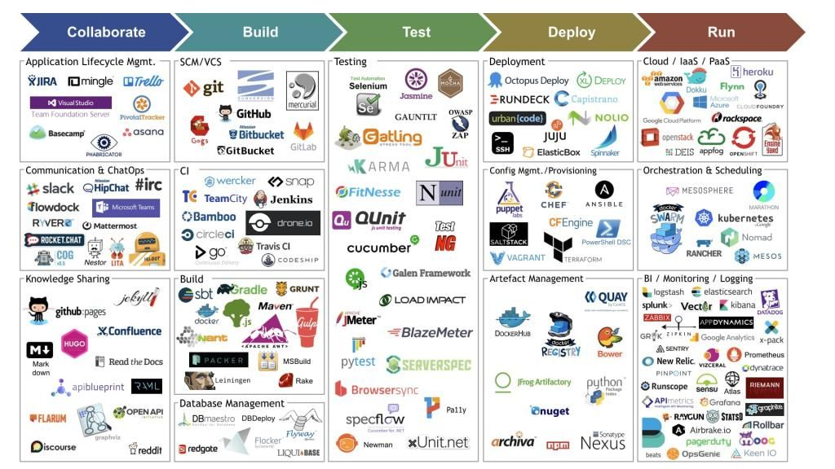
Delivery Tools – Engineering
This Photo by Unknown Author is licensed under CC BY-NC-ND

Slide 11
Reference to Delivery Play Book
Delivery Playbook v1.docx

Slide 12
Metrics Landscape and Operational Definitions

